Slide 1
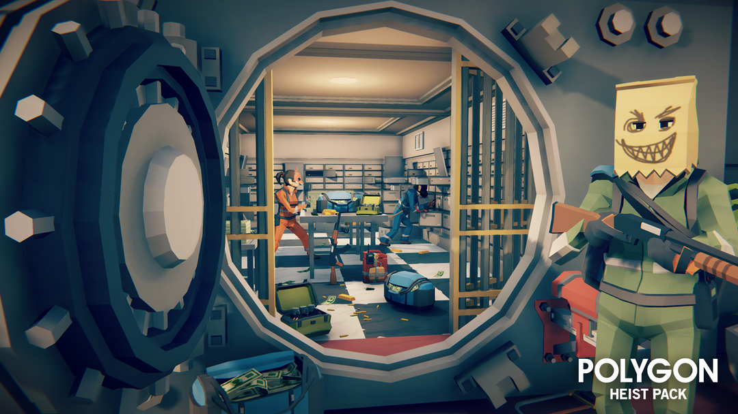
Heist of Reckoning
By Ethan, Matthius and Paul

Slide 2

Themes and gameplay
Themes: Platformer, RPG, Stealth
Core gameplay: Get to the getaway vehicle while escaping the police

Slide 3
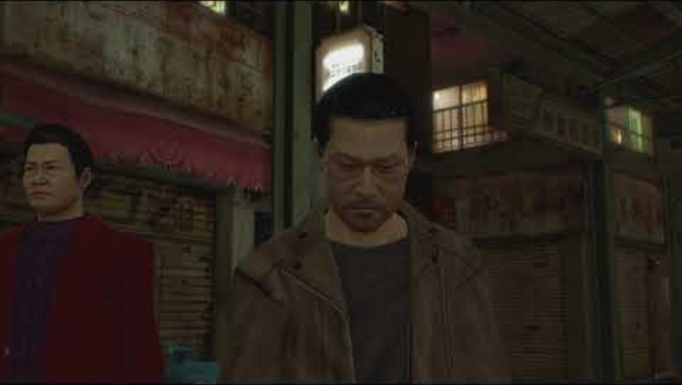
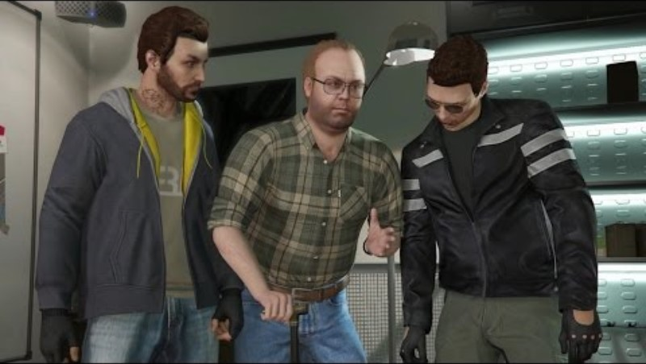
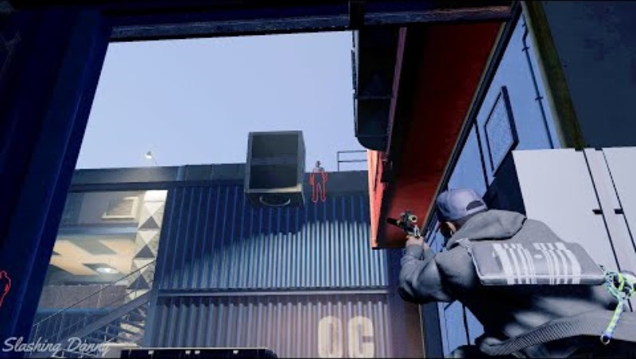
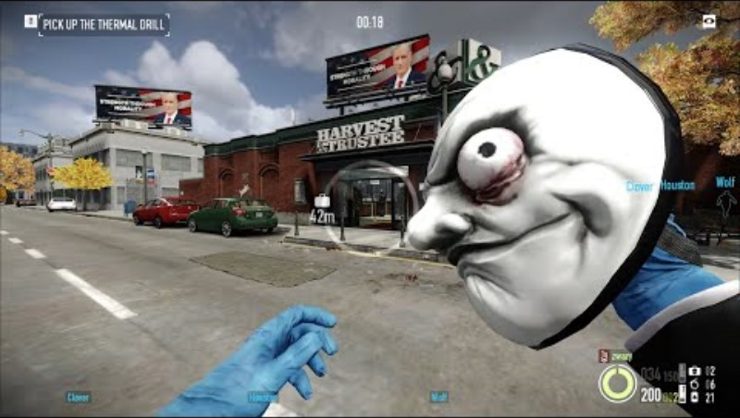
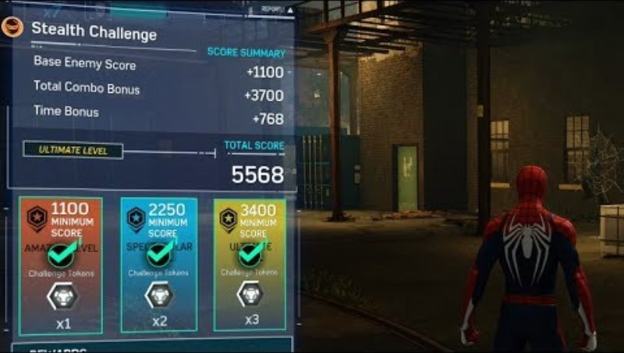
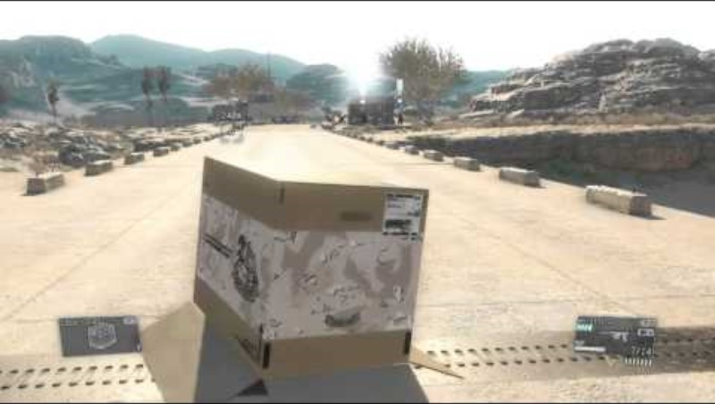
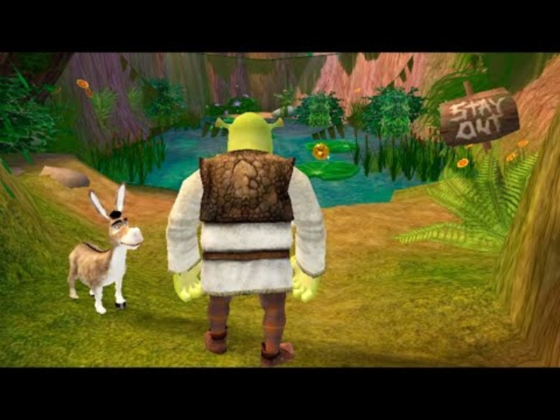

Inspiration
Video 1 - Yakuza 0
Video 4 – GTA 5
Video 7 – Watch dogs 2
Video 2 - Payday
Video 5 – Spiderman 2019
Video 8 – Metal gear 5
Video 3 – Shrek 2
Video 6 – Batman Arkham knight

Slide 4
Game Mechanics
Difficulty (Change the time of day)
Different routes (Building, Street, Sewers)
Local Multiplayer

Slide 5
Player Abilities
Throw money (Attract civilians to the area)
Disable camera (Hide from view)
Hide in box (to avoid camera)

Slide 6
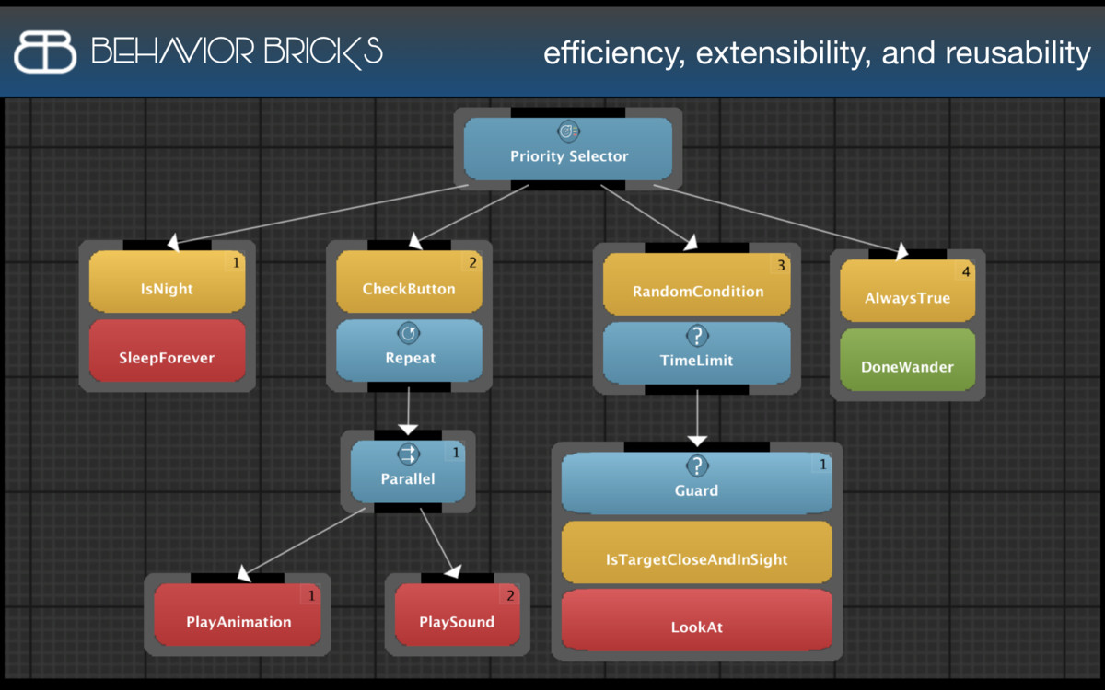
NPCs
Will use behaviour trees:
Police (Search, Arrest, Shoot)
Helicopter Police (Search, alert)
Civilians (Wander, Gather cash)
Image 1 – unity behaviour bricks

Slide 7
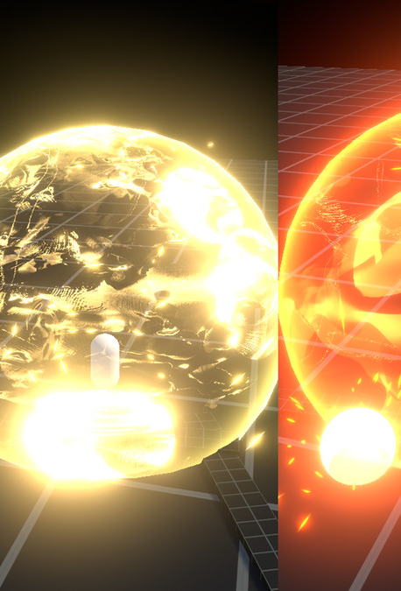
Graphics
Resolution 720 & 1080. Pro only 4k.
Different particle effects

Slide 8

Audio
Sound effects will be taken from royalty free sites
Sound effects for:
Throwing money, disabling cameras, hiding in boxes, shouting, being spotted, etc…

Slide 9

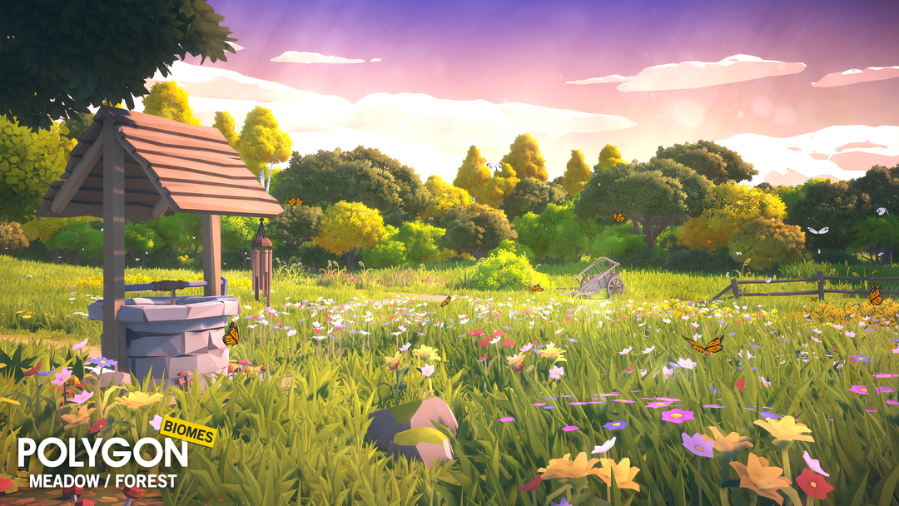
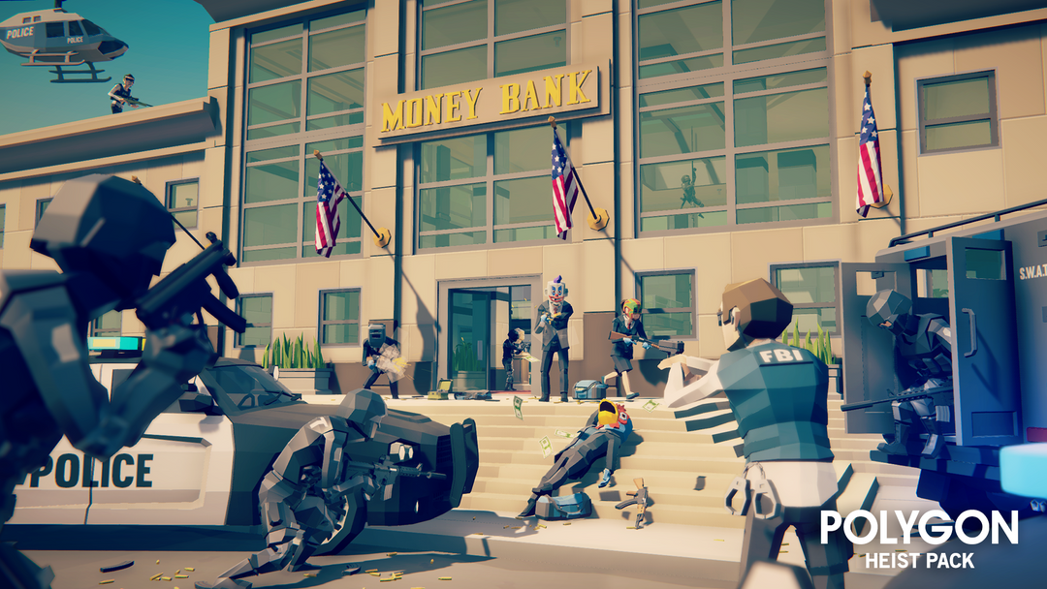
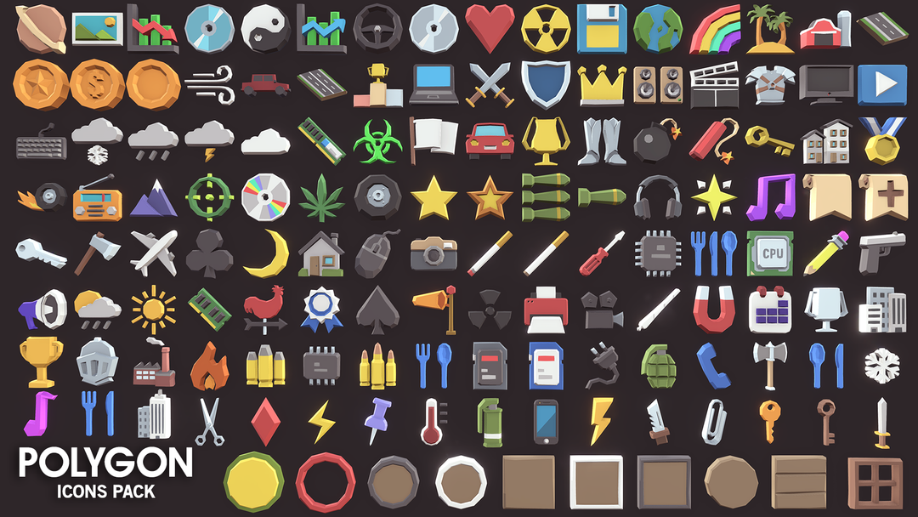
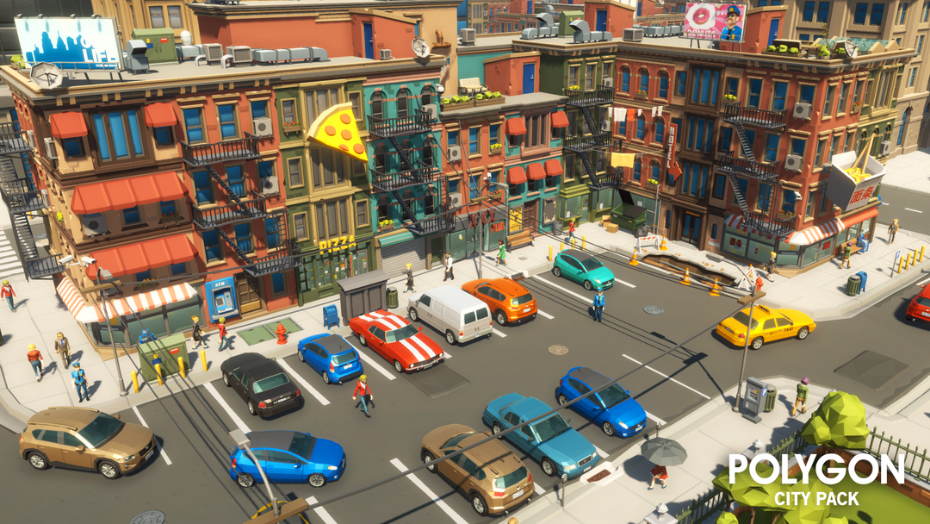
Assets
Figure 2 - ‌Synty Store. (n.d.). POLYGON - Heist Pack Game Assets - Find the Unity Asset in Store. [online] Available at: https://syntystore.com/en-gb/products/polygon-heist-pack?_pos=1&_psq=heist&_ss=e&_v=1.0 [Accessed 2 Feb. 2024].
Figure 3 - Synty Store. (n.d.). Simple Sky Cartoon Assets | Free Low-Poly Game Assets. [online] Available at: https://syntystore.com/en-gb/products/simple-sky-cartoon-assets?_pos=1&_psq=sky&_ss=e&_v=1.0 [Accessed 2 Feb. 2024].
Figure 4 - ‌Synty Store. (n.d.). POLYGON - Icons Pack Game Assets - Find the Unity Asset in Store. [online] Available at: https://syntystore.com/en-gb/products/polygon-icons-pack?_pos=1&_psq=icon&_ss=e&_v=1.0 [Accessed 2 Feb. 2024].
Figure 1 - ‌Synty Store. (n.d.). POLYGON - Nature Biomes - Season One Game Assets - Find the Unity Asset in Store. [online] Available at: https://syntystore.com/en-gb/products/polygon-nature-biomes-season-one?_pos=1&_psq=nature&_ss=e&_v=1.0 [Accessed 2 Feb. 2024].
Figure 5 - ‌Synty Store. (n.d.). POLYGON | City Pack Game Assets | SyntyTM Official Store. [online] Available at: https://syntystore.com/en-gb/products/polygon-city-pack?_pos=1&_psq=city&_ss=e&_v=1.0 [Accessed 2 Feb. 2024].

Slide 10
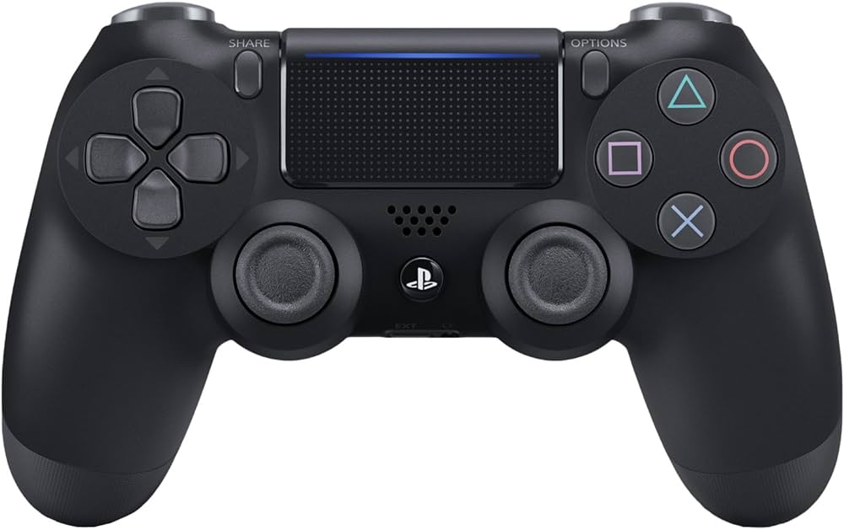
Controller features
Vibration (increase vibration when enemies get closer)
Touch pad (to move around the map)

Slide 11
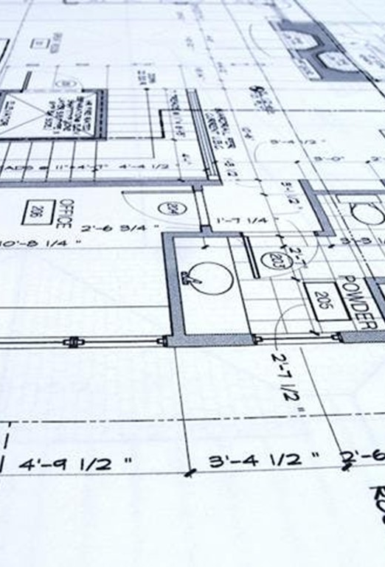
Development order
World Design | Audio | UI Design | Coding
Prototype

Slide 12
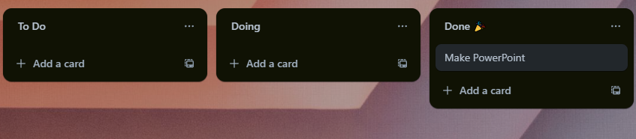
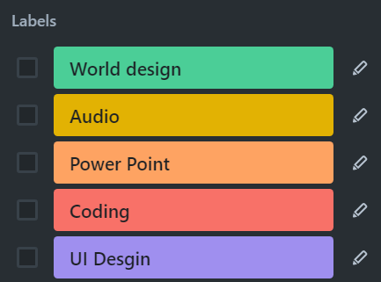
Breakdown of workload
Using Trello for Kanban
Allowing us to assign ourselves to tasks
Using labels to keep tasks clear
Ethan – World design / Coding
Paul – UI / Coding
Matthius – Audio / Coding

Slide 13
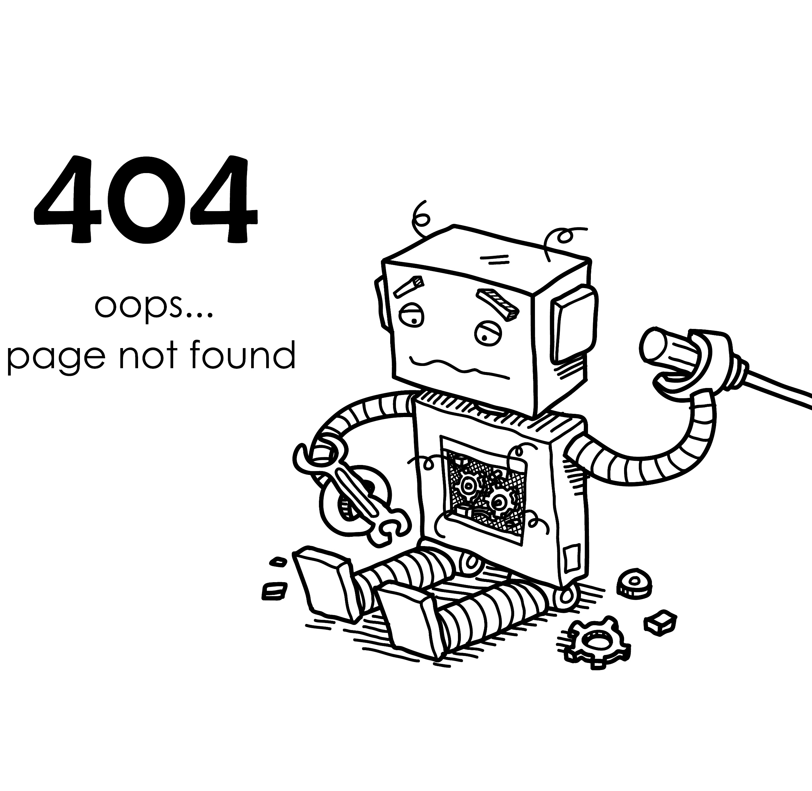
What if the plan goes wrong
Using royalty-free audio and UI elements.
Reduce scope of the routes
Use fewer sounds and animations

Slide 14

Planned features for prototype
One Route (partially finished)
One NPC
Limited audio

Slide 15

Thanks for listening
We hope you enjoyed

